Slide 1

Writing Strength-Based IEPs
Professional Development Video
Brent C. Elder, Ph.D.
Assistant Professor
Interdisciplinary and Inclusive Education
Rowan University

Slide 2

Agenda
Brief introduction
New Jersey statistics on inclusive education
Why social justice is necessary for inclusive education
Overview of strength-based approaches to writing IEPs

Slide 3
Who am I?
Inclusive school teacher
PhD in Special Education and Disability Studies
Assistant professor
Creating inclusive schools
Inclusion in schools/countries with extremely limited resources
Notes:
B

Slide 4
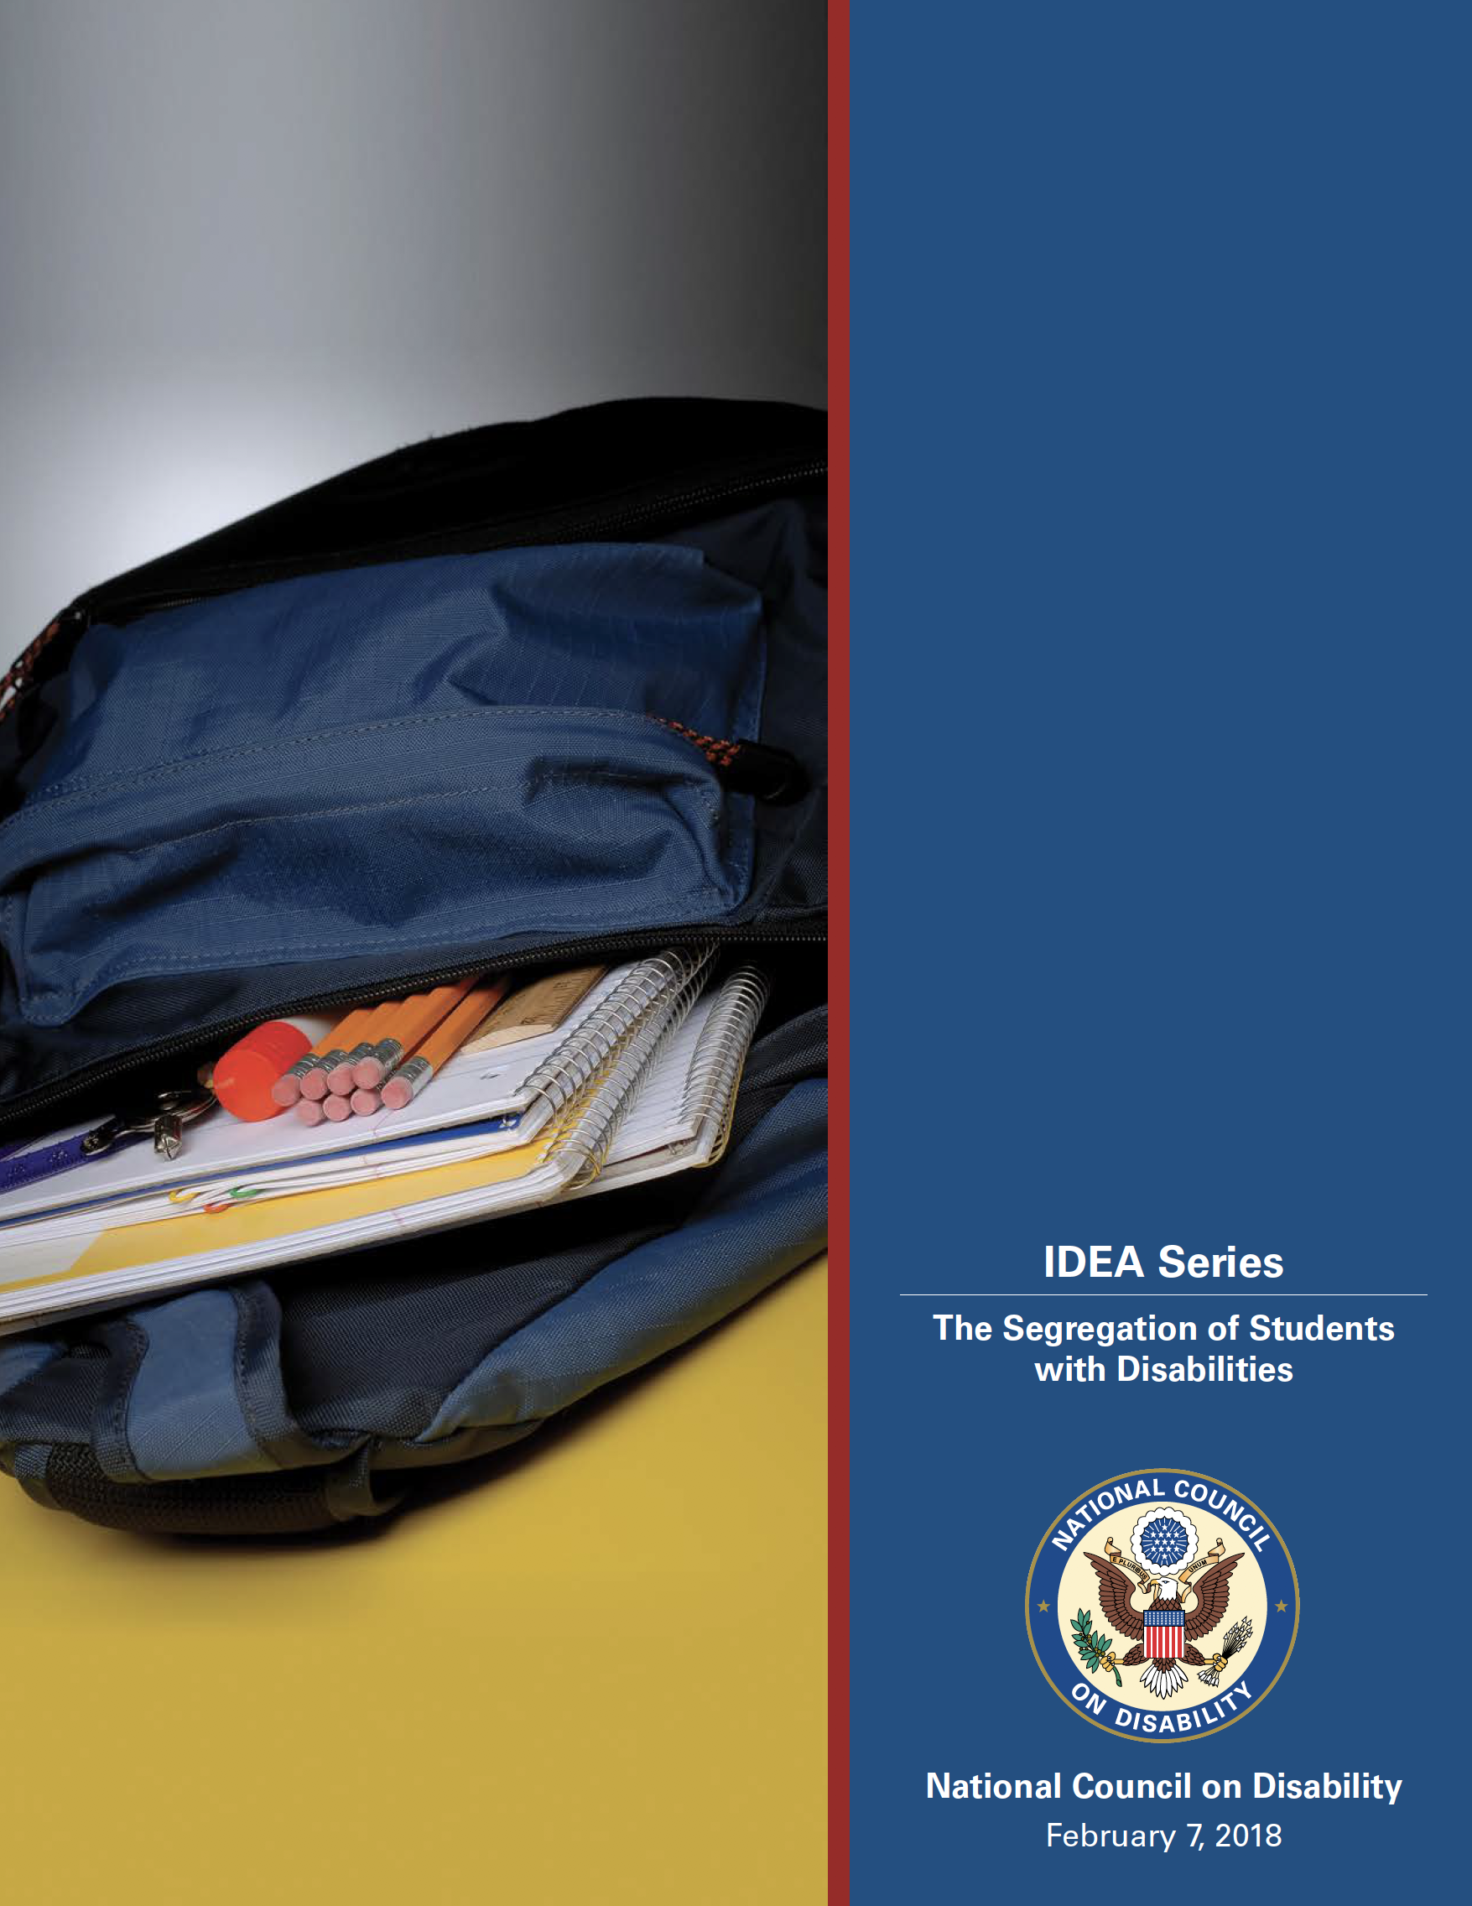
New Jersey Statistics on School Segregation (National Council on Disability, 2018)
Notes:
B

Slide 5
Where does NJ rank for inclusive education practices in the US?
In the top 10?
In the top 11-20?
21-30?
31-40?
41-50?
Notes:
NJ ranks in the bottom three of US states and territories only ahead of Guam and Hawaii, respectively.

Slide 6
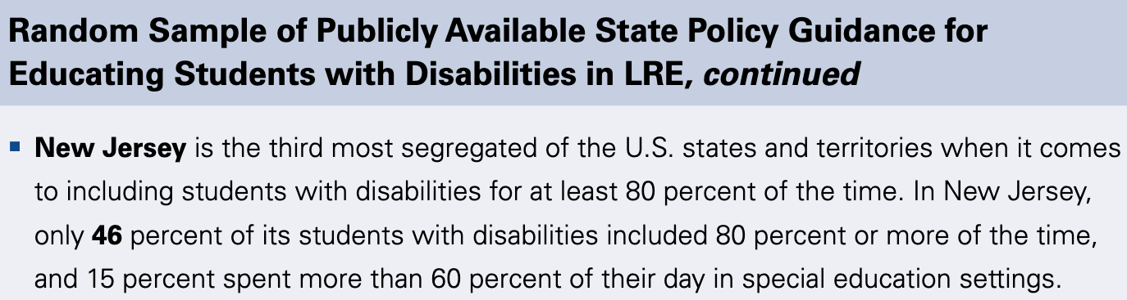
Where does NJ rank in the US?
Notes:
NJ ranks in the bottom three of US states and territories only ahead of Guam and Hawaii, respectively.

Slide 7
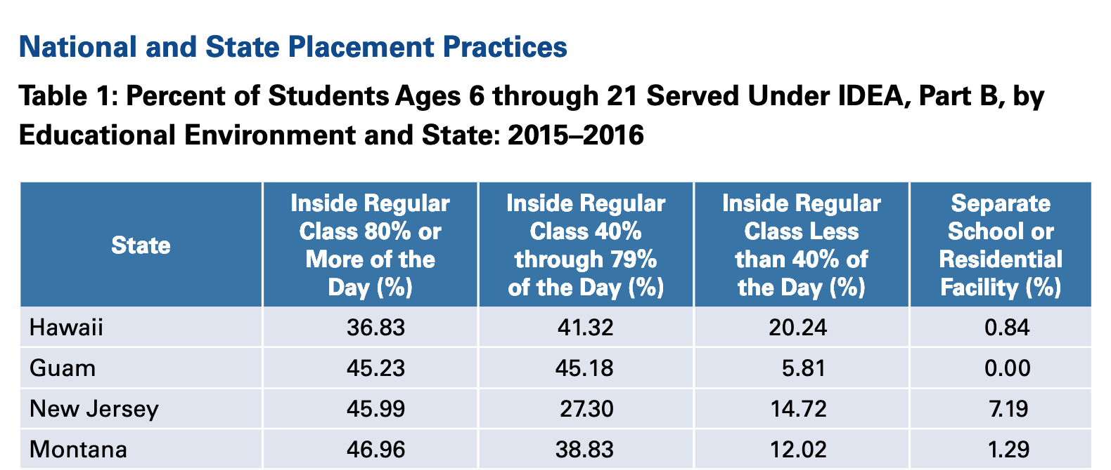
Where does NJ rank in the US?
Notes:
https://ncd.gov/sites/default/files/NCD_Segregation-SWD_508.pdf

Slide 8
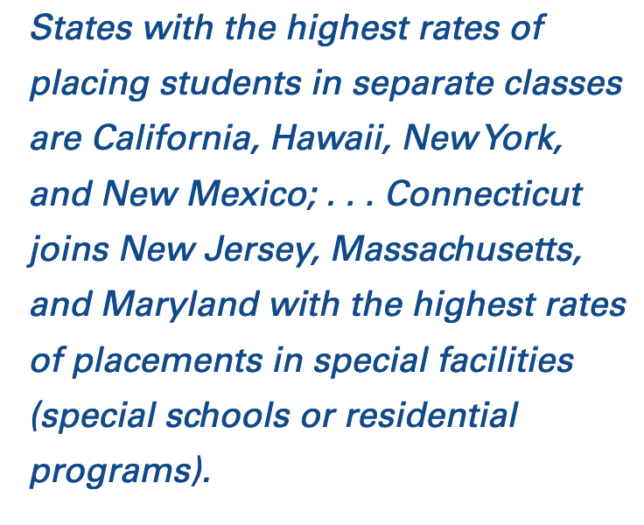
Where does NJ rank in the US?
Notes:
B
https://ncd.gov/sites/default/files/NCD_Segregation-SWD_508.pdf

Slide 9
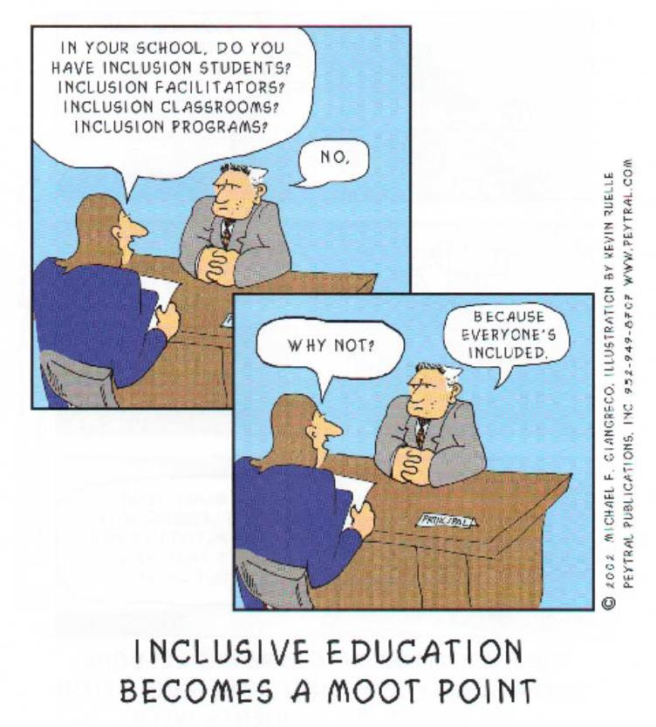
Foundations of Inclusive Education

Slide 10

Presumption of Competence

Slide 11
Disability Studies in Education (DSE)
Privilege the interests, agendas of people labeled with disability/disabled people
Promote social justice, equitable and inclusive educational opportunities, and full meaningful access to all aspects of society for people labeled with disability/disabled people; and
Assume competence and reject deficit models of disability (Connor, Gabel, Gallagher, & Morton, 2008, pp. 447-48)

Slide 12

Legal Foundation for Inclusive Education
Education for All Handicapped Children Act (Public Law 94-142) (1975)
Individuals with Disabilities Education Improvement Act (IDEIA) (Reauthorization in 1990 & 1997)
Free and Appropriate Public Education (FAPE)
Least Restrictive Environment (LRE)
Endrew v. Douglas County School District (2017)

Slide 13
What does this mean?
Special education is not a place
It is a service that follows the student
Neighborhood schools
Students do not have to all have the same goals and outcomes to get benefit
Supplemental supports, aids, and services
Shift from, “Can we?” to “HOW can we?”

Slide 14

What is social justice?
Fairness, dignity, equity
Valuing race, culture, family, economic, sexuality, spirituality, disability
Abolishing segregation
Equity in schools
Heterogeneous neighborhood schools
Civil rights
Removing harmful double standards
Removal of we/they binaries
(Connor et al., 2008)

Slide 15

Inclusive Education as Social Justice
Unok-Marks (2011)- Resource

Slide 16

Tools/Approaches that Promote Writing Strength-Based IEPs
Strength-Based Language
Person-Centered Planning
PLAAFPs and Benchmarked IEP goals
Action Plan Meetings
IEP Matrices
In-Class Checklists and Strategies

Slide 17
A Deeper Dive
For a more in-depth explanation of writing strength-based IEPs, see Elder, Rood, & Damiani (2018)
Can be read as individual sections or read as a whole
Taken together- well-oiled inclusive education machine

Slide 18
References
Biklen, D., & Burke, J. (2006). Presuming competence. Equity & Excellence in Education, 39(2), 166-175.
Connor, D. J., Gabel, S. L., Gallagher, D. J., & Morton, M. (2008). Disability studies and inclusive education: Implications for theory, research, and practice. International Journal of Inclusive Education, 12(5-6), 441-457.
Elder, B. C., Rood, C. E., & Damiani, M. L. (2018). Writing strength-based IEPs for students with disabilities in inclusive classrooms. International Journal of Whole Schooling, 14(1), 116-153.
Individuals with Disabilities Education Improvement Act (2004), 20 U.S.C. 614 et seq.
National Council on Disability. (2018). IDEA Series: The segregation of students with disabilities. Retrieved from https://ncd.gov/sites/default/files/NCD_Segregation-SWD_508.pdf
U.S. Department of Education (2000). Questions and answers about provisions in the Individuals with Disabilities Education Act amendments of 1997 related to students with disabilities and state and district-wide assessments. . Washington DC: Office of Special Education Programs, Office of Special Education and Rehabilitative Services.
U.S. Department of Education (2000). Twenty-second annual report to Congress on implementation of Individuals with Disabilities Education Act. Washington, DC: author.
U.S. Department of Education (2006). IDEA regulations: Individualized Education Program. Washington DC: author. Retrieved from http://idea.ed.gov/explore/view/p/.root.dynamic.TopicalBrief.10
Unok-Marks, S. (2011). Special education: More about social justice, less about caring. Phi Delta Kappan, 93(1), 80.

