Slide 1
College of Education
Adjunct Faculty Orientation
Fall 2023
Dr. Melissa Awenowicz
Assistant Dean

Slide 2
dada
We are thrilled you have decided
to serve the Rowan Community!
We appreciate your experience and
value your expertise in so many diverse areas!

Slide 3
Agenda
Agenda
Welcome/Introductions
CED Mission and Conceptual Framework
Nuts and Bolts of Hiring and Paperwork
Navigating James Hall
Learning Resource Center - South (LRC-S)
Addressing Student Issues
Assessment, Canvas, TK20, and Technology
Questions and Closing Thoughts

Slide 4
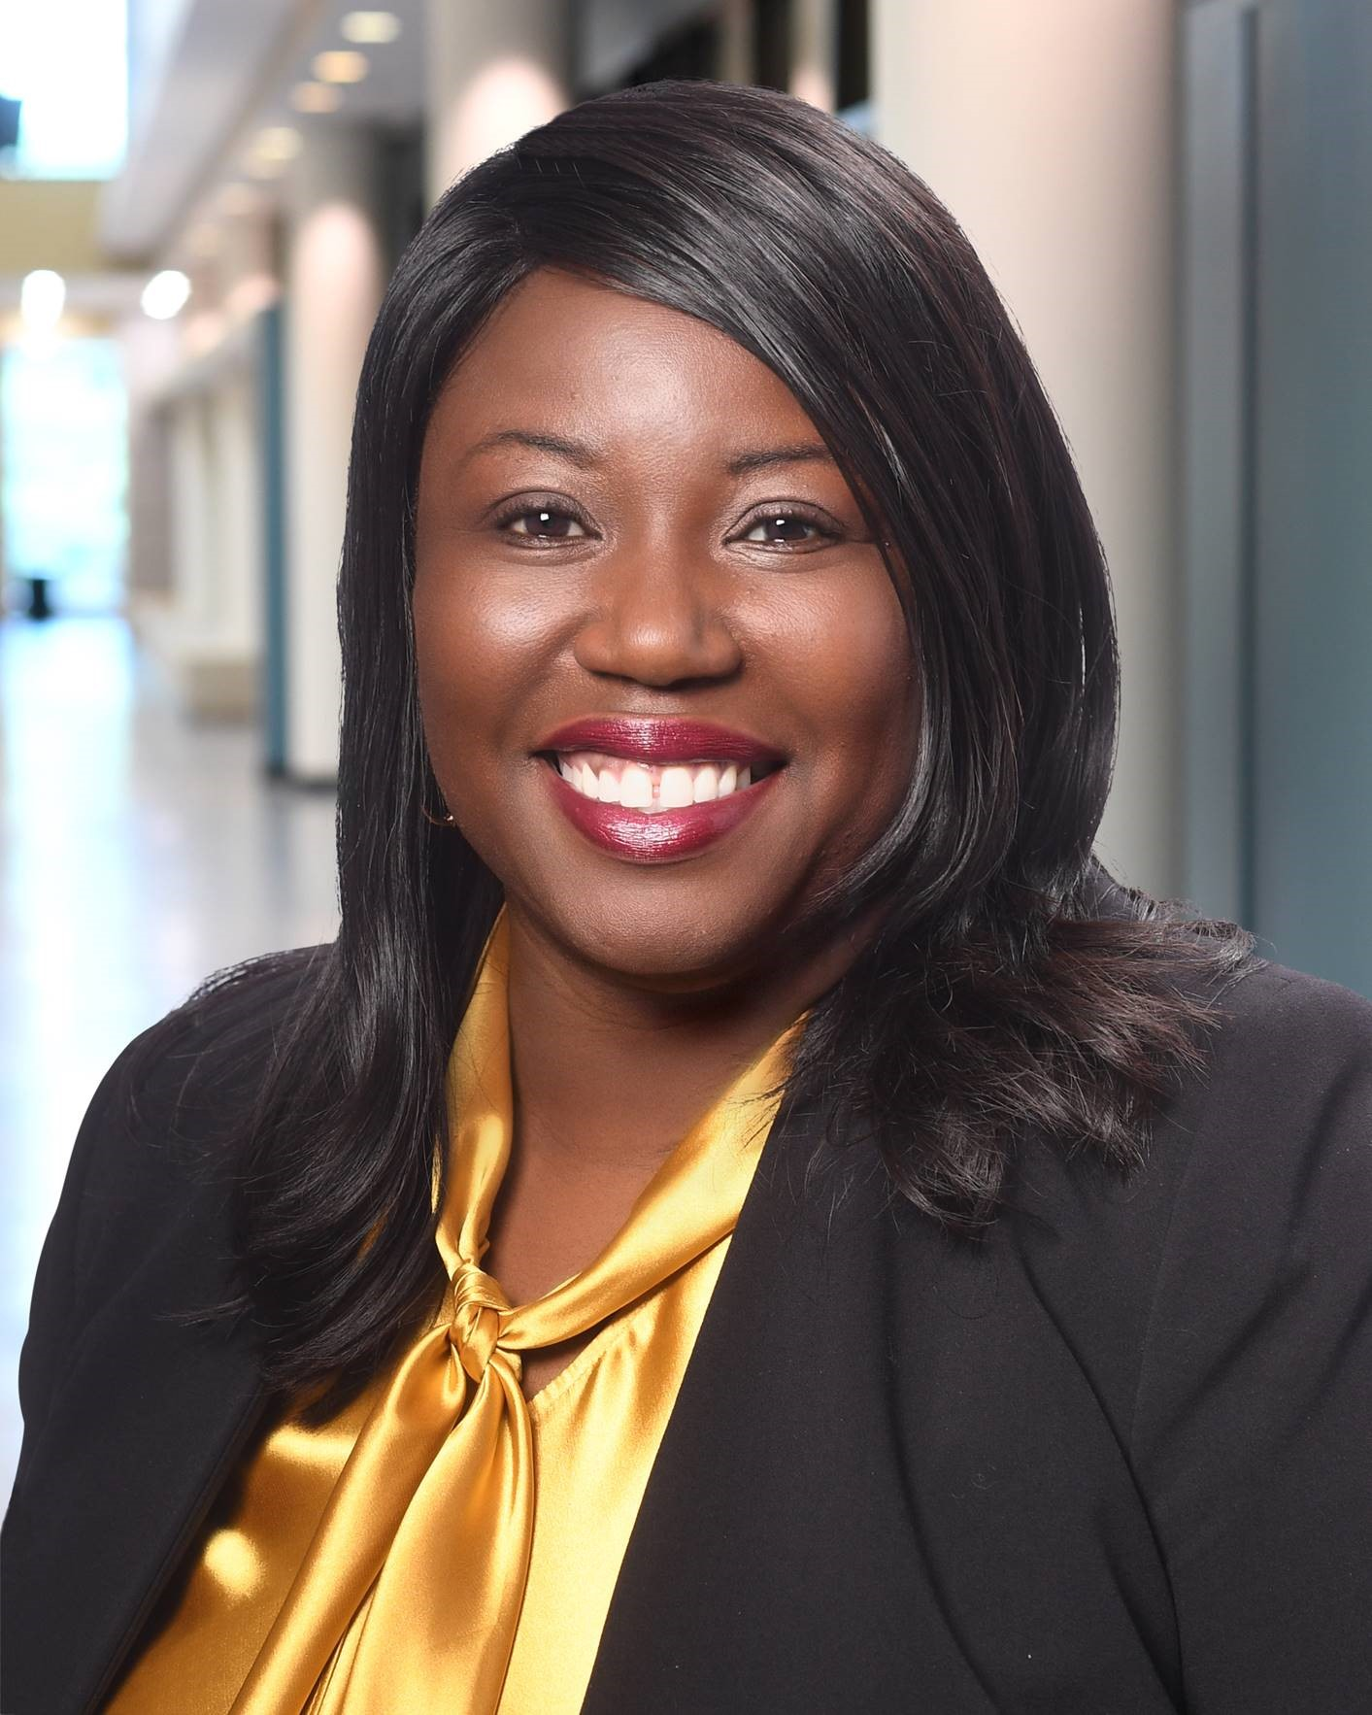
Welcoming Remarks
Dr. Gaëtane Jean-Marie
Dean,
College of Education

Slide 5
CED Vision and Tagline
Vision
The College of Education will be a leading force in preparing and supporting reflective practitioners who use education to transform our global society
Access, Success, and Equity… Turning Research Into Practice

Slide 6
Noteworthy Items in AY23-24
Excellence in Educator Preparation Accreditation
Restructuring from 4 Departments to 5 Departments for Effectiveness, Efficiency, and Continuous Improvement

Slide 7
CED Mission
To positively impact and develop local, regional, national and global educational communities by:
Collaborating with partners in the field to promote learning and the mental and physical health of diverse learners in all settings
Integrating teaching, research, and service to advance knowledge in the field
Preparing and supporting professionals through the development of knowledge, skills and dispositions
with the ultimate goal of ensuring equitable educational opportunities for all learners.

Slide 8
CED Conceptual Framework

Slide 9
CED Dean’s Office
Dean, College of Education - Dr. Gaëtane Jean-Marie
Associate Dean, Research & Innovation – Dr. Molly Fisher
Assistant Dean, Assessment & Accreditation -
Dr. Melissa Awenowicz
Executive Director of the Office of Educator Support and Partnerships - Dr. Stacey Leftwich
Communications & Events Coordinator – Mr. Michael Fromm
Assessment Coordinator – Mr. Dennis Rivera
Administrative Assistants - Karen Rosa, Angela Steward
Notes:
Data administration, collection, and analysis, CAEP accreditation, SPA reports, Title II reports, Graduate programs, TK20/Watermark, Registrar’s Office liaison
Office of Clinical Experiences, Professional Development School Network, edTPA Performance Assessment, Teacher Pipeline Programs and Recruitment, the Praxis Lab, and the Teacher Education Advisory Council, Teacher Preparation Programs

Slide 10
CED Departments AY23-34
EEC-Dr. Isik Ercan
Early Childhood, Elementary Ed, and Critical Foundations
Early Childhood, Teacher Leadership, Teaching in Urban and Diverse Settings, Ed. Minor, Teaching & Learning, Early Childhood STEM Education, Elementary Education Programs
CTLM- Dr. Chen
Critical Literacy, Technology, and Multilingual Education
CATE-Dr. Wieman
Content Area Teacher Education
Subject Matter Teaching –ELA, SS, Languages, Art, Music, HPE, Science, Math, Theater, STEM, Driver’s ED, Environmental Studies, and the Holocaust & Genocide
WISE- Drs. Morettini and Accardo
Wellness and Inclusive Services in Education
ELAR-Dr. Mitani
Educational Leadership, Administration, and Research
Reading, ESL and Bilingual/Bicultural Studies, Literacy Studies, Educational Technology
Inclusive Education, TOSD, Nursing, Autism, Special Education, ECSE, School Psychology, Counseling in Educational Settings, LDTC, Learning Disabilities, Supporting Mental and Social/Emotional
Leadership Studies, Leadership and Social Innovation, Access, Success, Equity, Supervisor Cert., Chief School Administrator, Principal, Higher Education, School Administration, Educational Leadership,, PhD/EdD –Education, Student Personnel Services, Student Assistance Coordinator, Supervision Curriculum Development
Notes:
Lori

Slide 11
Any questions throughout the year should be directed as follows:
Your Department Administrative Staff Person-supplies, materials, general questions, parking
Your Program Coordinator-course questions, grading questions, scheduling, student concerns
Your Department Chair-unresolved student issues and course concerns
Mrs. Angela Steward – contract questions
Mrs. Karen Rosa – building and room questions
Please, do not call the Provost’s Office with CED related questions –you will be referred back to the CED.

Slide 12
Communication Platforms
Explore the CED landing page
of note is the updated:
Faculty and Staff Resources
There is a section specifically for adjuncts and numerous free professional development opportunities available.

Slide 13
So now you are a
Rowan Adjunct …
here are many of the things of which you need to be aware…

Slide 14
Rowan ID Cards
Your Rowan ID is your swipe cards for building and classroom access and copier use in Adjunct Suite
You have same options as candidates—you may load funds onto these cards and use them in campus dining facilities as well as at numerous off-campus locations in Glassboro area
Available at Rowan Card Services Office
https://sites.rowan.edu/rowancard/
By Appointment only!!
ROWANCARD OFFICE
201 Mullica Hill Rd. Savitz Hall, Room 245 Glassboro NJ 08028 856-256-GONE(4663) Hours: Monday, Tuesday, Thursday: 8:30am-4:30pm Wednesday: 8:30-6:00pm Fri: 8:30am-4:00pm Sat/Sun: CLOSED rowancard@rowan.edu

Slide 15
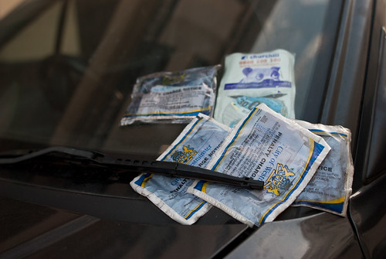
Parking
When you are on campus, you have two options for parking: obtain a parking permit sticker for your car or stop at the Visitors’ booth on 322 each time. Don’t risk getting a ticket because you do not have your vehicle(s) registered. http://www.rowan.edu/safety/parking/permit.html
Be sure to park in the correct lot and not in a reserved space! The lots on
either side of James Hall are
fine IF you have a permit.
We cannot “fix” tickets!

Slide 16
Need space to work
in James Hall?
Adjunct Suite 3rd floor middle of office corridor, access from both sides of hallway
Desks: most adjuncts attach a business card or name so that candidates can find them! Some locking cabinet capability, if needed
Laptop-friendly with printing access
Copier (for emergency copying only; need ID)
Due to high printing costs, you are encouraged to use Google Docs, or Canvas to share readings, materials, and resources with candidates.

Slide 17
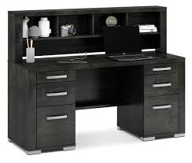
James Hall
Offices – adjunct faculty and supervisors do not have private offices; if you need space to meet with a student that is more private than adjunct suite, discuss this with your department chair-a suitable place can be found for a meeting
Office of Clinical Experiences and College of Education Advising Center – 2nd floor, athletic fields side of building
Hours: 8:30-4:30, Monday through Friday
Main Center on 2nd floor, advisors’ offices there, too
After hours, see your departmental secretaries for assistance

Slide 18
Paperwork
Be sure all required documents are on file with department secretary, HR, and payroll
Self-Service Banner – Employee Dashboard-Enter Time-Access Time Sheet
You can also access your pay stubs here.
If you are supervising and will request travel reimbursement, you must use Concur.
https://sites.rowan.edu/accountspayable/travel/concur_t_e/concur_training.html

Slide 19
You will receive your Contract when notified via email

Slide 20
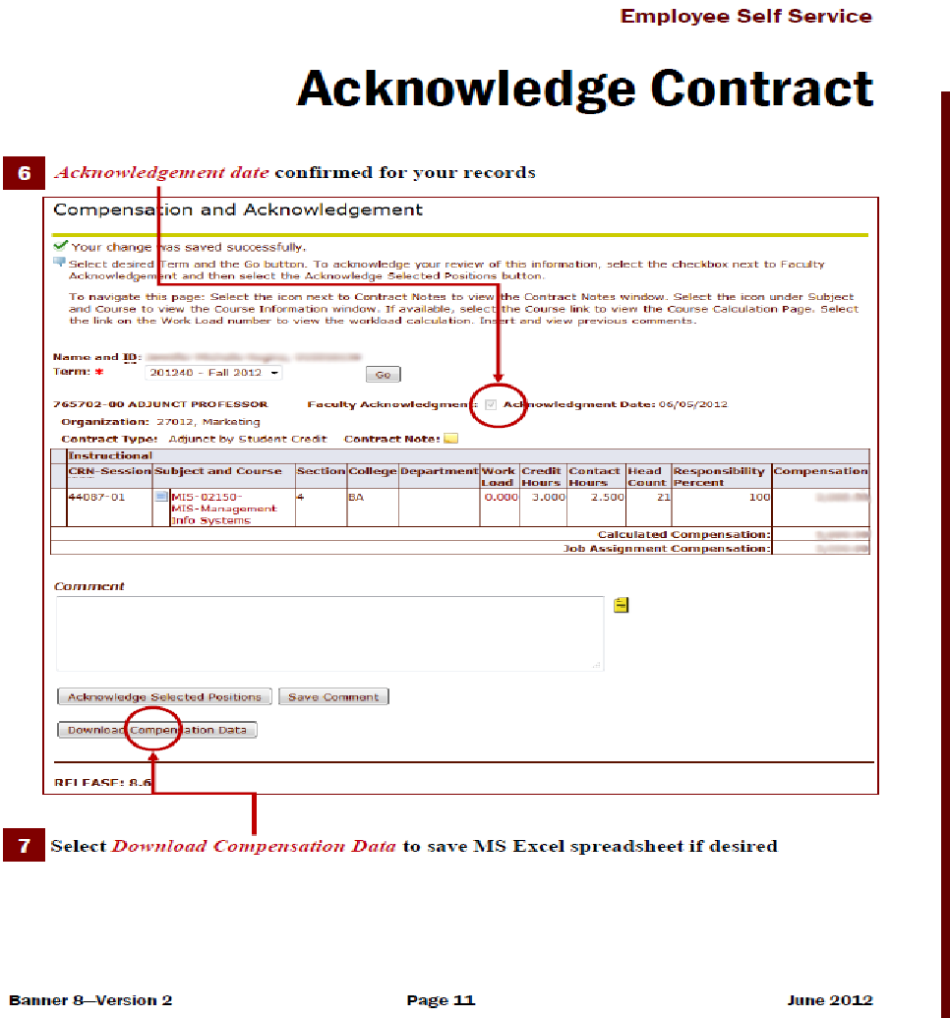
Your Contract

Slide 21
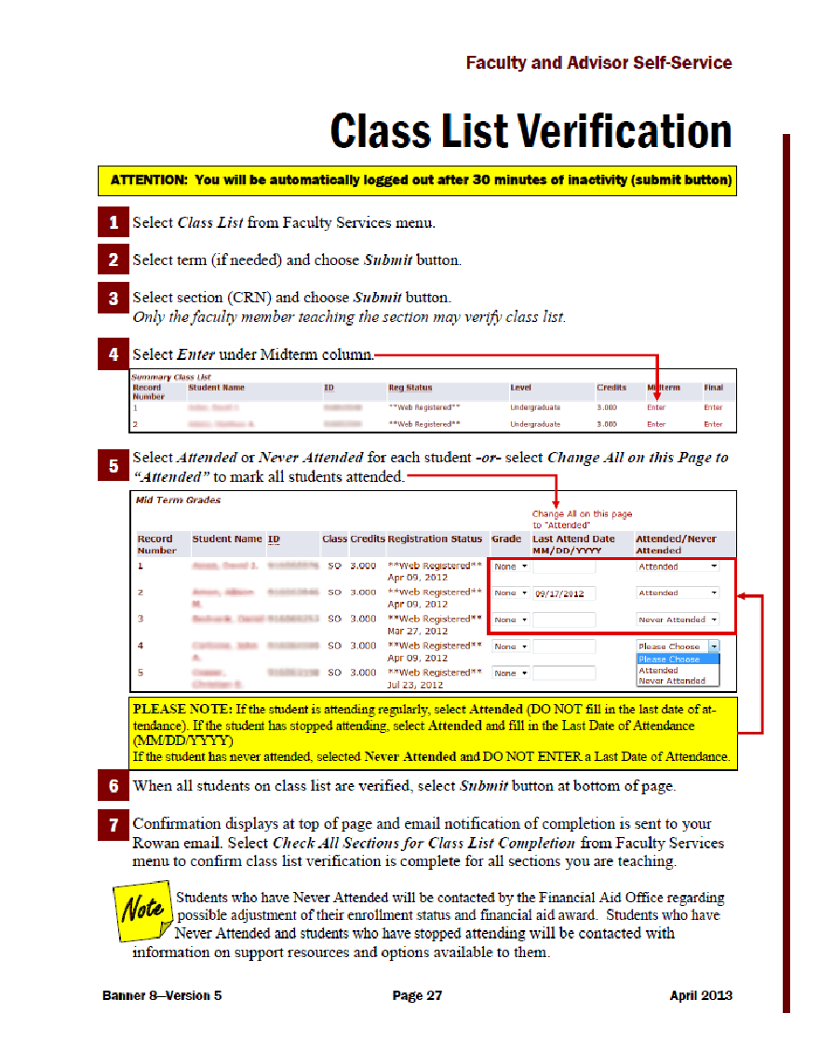

Slide 22
A Syllabus is required for each Course you teach, each semester
1. There is a required template for you to use that has the mandatory information.
https://go.rowan.edu/SyllabiTemplate20232024
2. You may add additional information.
3. Due to the Department Secretary within first week of semester [will be turned in to Dean’s Office for archiving]. It should also be shared with students.
4. Even Field/Clinical Experiences and Practicums/Internships require syllabi.
5. Check with your Chair/Course Facilitator to see if a syllabi has been created for the course you are teaching – you may only need to add your information.
6. You must include the course number and course description that is in the course catalog – this should NOT be altered.

Slide 23
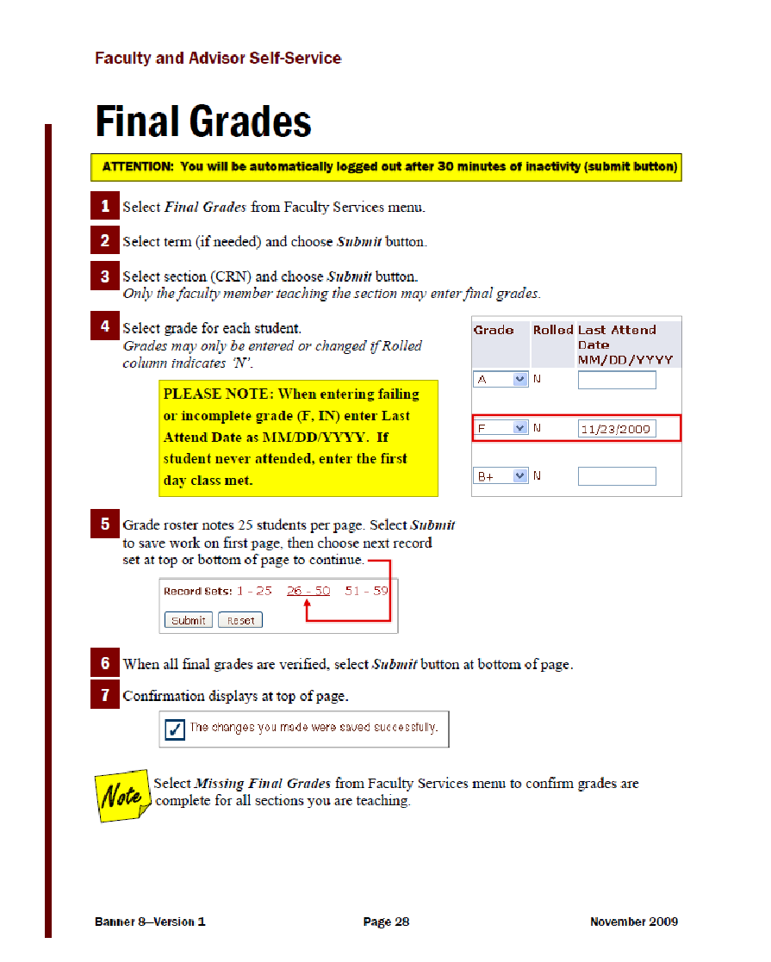

Slide 24
Resources and Materials

Slide 25
Rowan Success Network
(Also referred to as RSN)
Use to alert students of concerns and issues, provides documentation, and alerts appropriate support services across the University
Opportunity to provide students with feedback – be constructive, specific.
Must be completed at the mid-point of each semester. Email reminders are sent.
Please be prompt with your responses! (Plan for about 25 minutes for average-size class).

Slide 26
LRC-South Center: James Hall 1140
Learning Resource Center - South
The Learning Resource Center Network, a program of the New Jersey Department of Education, is funded through IDEA Part B funds and promotes usable innovations and evidence-based practices of inclusive education through the availability of resources, services, and professional learning opportunities.
Our services include a lending Resource Library, low-cost Production Center, no-cost Xpress/Curbside Service, Mobile Delivery to education sites, no-cost Family & Community Resources and Events, no-cost Professional Development, and Technical Assistance designed specifically for school districts.
The only cost to patron is an annual membership fee of $2.00. Please join today!
For addition information, visit our website
or contact us at:LRC_south@rowan.edu
Notes:
Current education information is available at the SLRC through library media, professional journals, video/DVD collections, and access to on-line research relevant to educators and parents having responsibility for children and youth with disabilities ages 3-21.
Materials Circulation Services
The LRC maintains and loan an extensive collection of professional books, in-service/pre-service training resources, activity books, videos/DVDs and instructional materials to support all areas of the general education curriculum.
Production Services
Ideas are available for the development of teacher and parent-made learning materials. Services include lettering machines, laminating, transparency making, button making, poster making and photocopying. Supplies are available for purchase (no cost for Rowan College of Education students who hold membership ($2.00 per year)
Mobile Outreach Services
The LRC operates a Mobile Outreach service for delivery of resources within its region. The van delivers a variety of classroom materials and professional resources (videos/DVDs, games, books, and kits) to participating teachers/service providers.

Slide 27
James Hall
Distance Learning Lab - virtual teaching experiences through The Teaching Channel; all ITP programs have embedded this experience in at least one course; to receive access please email your request to TK20@rowan.edu

Slide 28
Campbell Library Resources
Library Contact
Ashley Lierman
lierman@rowan.edu or ext 4979
Library gives you access to many resources
Link to Rowan through Google Scholar to access articles (please let your candidates know this as well)
“Help” button on library gives you multiple options to find assistance with library materials
Following slide is from Campbell Library

Slide 29
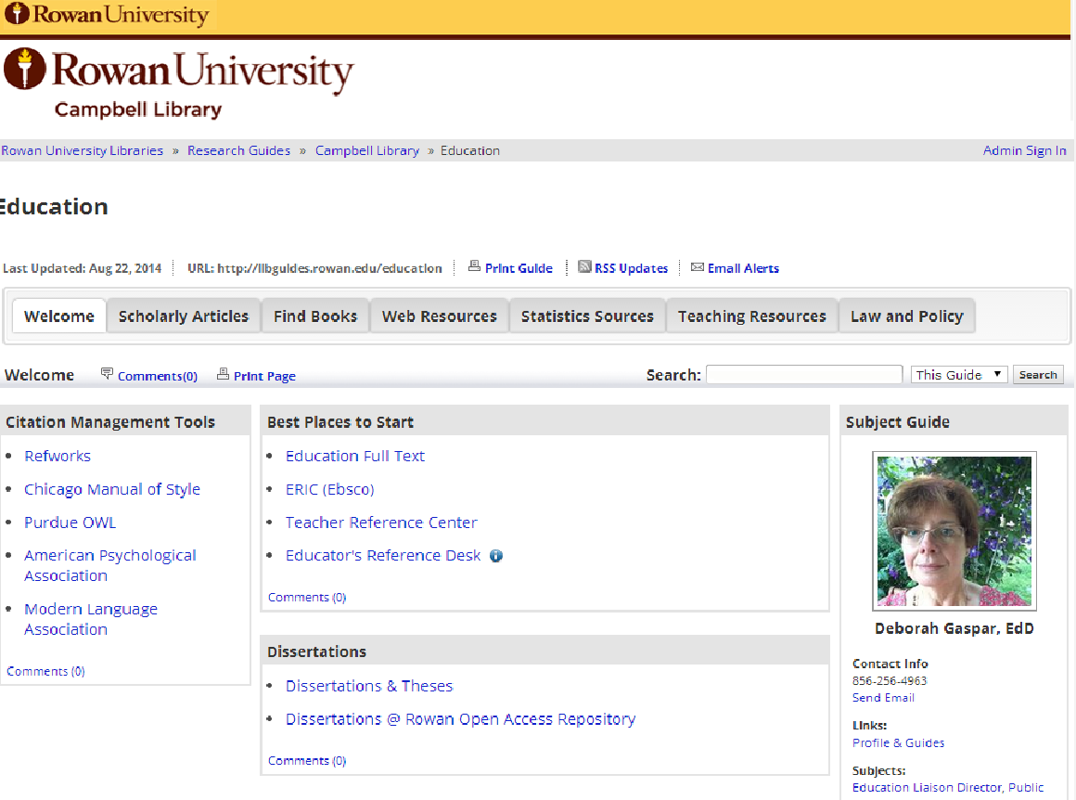

Slide 30
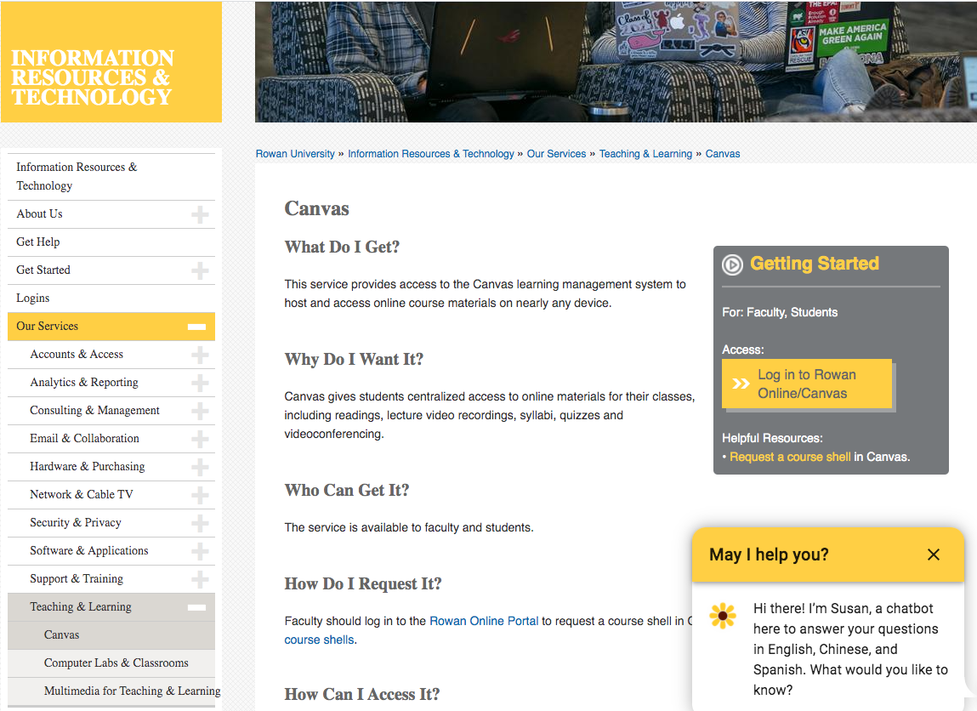
Canvas Course Platform
All courses can be supported by Canvas.

Slide 31
Assessment Policies & Procedures
TK20 Assessment Management System
Provides a set of tools for candidates and
faculty that track candidates' learning, as well as make our data collection, assessment and accountability tasks easier.
Selected courses have key assessments sent through and assessed within Tk20; your course facilitator can tell you if your class has a key assessment for which you will need to record the rubric data in TK20.
Stores the data needed for Assessment and Accreditation.
Notes:
Tk20 is the assessment management system used by Rowan’s College of Education. It is the place where we collect and store all assessment data for our programs, including all key assessments, clinical placement data, and dispositions data.
A key assessment is an assessment that is completed by all students across all sections of an identified course. The students are scored using the same rubric. This process allows us to determine the extent to the program is preparing its students toward selected standards. Key assessments are embedded into selected courses; check with your course facilitator or program coordinator to learn if your course has a key assessment.
All key assessments are sent to students and their faculty member through Tk20. If you are new to Tk20 and would like a demo, please contact Bruce Wilson -- his contact information is on a coming slide.

Slide 32
What is the difference between TK20 and Canvas? discuss

Slide 33
Policies and Procedures
This Photo by Unknown Author is licensed under CC BY-ND

Slide 34
Policies and Procedures
Office Hours
If you are teaching, you are required to hold office hours each week; generally, 1 hour per week. Please supplement your 1 hour using email, video chats, phone conferences, and texts to communicate with students as
necessary between classes. Post office hours
and contact information on syllabus.
Rowan Email
It is absolutely essential that you set up and USE your Rowan email. This is the way we communicate with you. Rowan email may be forwarded to a personal email, but we will NOT use personal email addresses.
Use ONLY your Rowan email for all communication with candidates.

Slide 35
Policies and Procedures
Duplicating
ALL duplicating (except for an emergency need) should be sent electronically to the duplicating center or sent via your departmental secretary. http://www.myorderdesk.com/home.asp?Provider_ID=29525
If sent as a “paper” request, generally expect one week to process
Department secretaries can give you all the needed numbers/codes to submit electronically
Due to high printing costs, we encourage you to use Google Docs, Canvas, email to share readings, materials, and resources with candidates.

Slide 36
Policies and Procedures
Classroom Technology issues
Contact Rowan University Support Desk at support@rowan.edu, or 856-256-4400
Syllabus
MUST use the College of Education Syllabus Template! Please ask your Department Chair for the required syllabus template.
Include the following link on each syllabus:
https://go.rowan.edu/CEDSyllabiPolicies
Notes:
The James Hall Technology Office is now operating with fewer student workers and less hours per week. If you have an immediate technology need for your classroom or Rowan owned computer, please contact Rowan’s Information Resources and Technology Office at the email or phone number of the screen.

Slide 37
Tk20 Policies and Procedures
ALL key assessment data is stored in TK20, including all observations and final evaluations for candidates while in clinical practice (year 4, full-time student teaching).
Data must be entered into TK20 within 1 week following the end of the course, however, it is best to enter it as
you go through the semester,
immediately after completing
an observation or task.
Notes:
As the assessment management systems for the College of Education, Tk20 is the place where we collect and store all assessment data for our programs, including all key assessments, clinical placement data, and dispositions data.
The assessments are sent out to candidates and their associated faculty members, university supervisors, and / or clinical placement mentors through Tk20. The faculty, supervisor, or mentor then evaluate the candidate directly within Tk20.
Evaluation data are to be entered within one week after the end of the course. Please make every effort to ensure that your data are entered timely. Faculty will receive a reminder 1 week prior to the end of the semester, during the last week of the semester, and for those who have outstanding data, one week after the end of the semester. After that time, program coordinators and department chairs will be notified of the missing data entries.

Slide 38
Tk20 Support
Need help with Tk20/Watermark?
Assistant Dean – Dr. Awenowicz, 64753
Assessment Coordinator-Dennis Rivera
Tk20@rowan.edu
Rowan Tk20 Support Website
856-256-4000, ext. 53020
Watermark: 1.800.311.5656
Notes:
If you are new to Tk20 and would like a demo, please contact Bruce -- his contact information is on the screen.

Slide 39
Tk20 Syllabus Language
This is required on all syllabi for course with a key assessment
“Please note that the scoring rubric and assignment description for (Key Assessment name) will be available for you on the College of Education Tk20 system. Tk20 is a comprehensive data management and learning outcomes assessment management system that provides a rich set of tools for candidates and faculty that help track and enhance candidates' learning, as well as make our assessment and accountability tasks easier. Please follow the link below to log into your Tk20 account and submit your assignments:
https://login.rowan.edu/cas/login?service=https://rowan.tk20.com/campustoolshighered/portallogin_body.do
An assignment will not be graded unless it is submitted on Tk20. If you have questions about Tk20, please review the Rowan Tk20 Support site which includes FAQs and avenues of available support.

Slide 40
Policies and Procedures
Academic Integrity:
The University takes this very seriously and every faculty member must be vigilant in adhering to policy. You probably want to be nice to your candidates because you truly care about them, but if there is a violation, it MUST be reported. http://www.rowan.edu/provost/policies/AcademicIntegrity.htm
Reference to the policy and the seriousness of violations must be on EVERY syllabus
For more information about policies and procedures, please visit: https://academics.rowan.edu/education/Policies/index.html

Slide 41
Policies and Procedures
Whenever a student has an issue, the following procedure MUST be followed:
Student meets and discusses issue with professor. If no satisfactory resolution,
Student meets with Department Chair (all necessary information provided by both faculty member and student prior to meeting). If no satisfactory resolution,
Department Chair meets with faculty member and student together. If no satisfactory resolution,
Student requests a meeting with the Associate Dean of the College (all necessary information provided by Department Chair and student prior to meeting). If no satisfactory resolution,
Student requests a meeting with the Provost.

Slide 42
Rowan Emergency Information
Rowan Emergency Information: http://www.rowan.edu/emergency/
Public Safety/Emergency Management: http://www.rowan.edu/safety/index.html
Active Shooter: How to Respond: http://www.rowan.edu/safety/information/shooter_response.html

Slide 43
Peer Observations
It is a requirement that all Adjuncts be observed periodically.
Please contact your Department Chair
for more information.

Slide 44
Student Evaluations
Every adjunct is required to obtain student evaluations in all courses.
Evaluations are shared each term with department chairs as ongoing academic affairs data.
Rowan Global online course?
Administration & collection
process is built-in.
Traditional course:
Student evaluations are being done through IDEA - https://sites.rowan.edu/academic-affairs/facultycenter/studentevals/
This is monitored by the Faculty Center and Natalie Kautz.
link is available in Rowan Online courses, but the faculty member must opt in if their department has opted in to use the tool.
PURPOSE: Evals provide evidence of quality teaching, support rehiring, and are part of our continuous improvement efforts.

Slide 45
is no longer an initial certification requirement in New Jersey for initial licensure candidates during student teaching. The CED will use the Danielson FFT performance assessment as a replacement and an Impact on Learning Key Assessment during CP2 as a replacement.
Notes:
edTPA is a discipline specific performance based assessment designed to evaluate a teacher candidate’s readiness to teach. This is a capstone project that is completed during the second semester of clinical practice (full-time semester). The assessment is scored by teacher educators and P12 teachers throughout the country.

Slide 46
Technology
Regularly update apps and software to avoid glitches!
Look for official Rowan University IT emails regarding ransomware and beware of email scams that appear “almost, but not quite right”
In James Hall...
Open Computer Lab (Room 1141)
Distance Learning Lab (Room 2093)
Card Swipe System
Notes:
We have a number of technological resources for our faculty. There is an open computer lab on the first floor of James Hall, 1141 that is for use by anyone.
Mursion is the virtual teaching program that is used by Rowan University. The program allows teacher candidates an opportunity to practice aspects of teaching, such as delivering a lesson, leading a small group, conferencing with parents, or managing classroom behaviors, in a safe, non-threatening environment. The program uses avatars as the students or parents and are controlled in the background by a real person at Mursion, the owners of the software. The avatars respond (physically and orally) to what the teacher candidates says and does. If you would like more information about this program contact Lori Kroeger at the email on the screen.

Slide 47
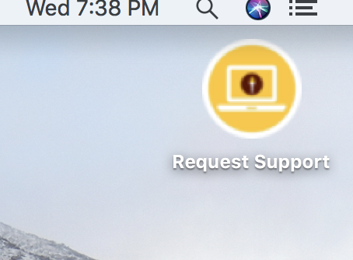
Technology Support
Rowan Information Resources and Technology
support@rowan.edu
856-256-4400
Request Support button
Support Center in Memorial Hall
CLICK HERE
Notes:
If you need technology support, please contact the Rowan Information Resources and Technology department at the email or phone number on the screen. If you are using a Rowan owned computer, you can also click the Request Support button on your computer.

Slide 48
Steps/Thoughts to Ensure Your Success and Effectiveness
Establish and consistently adhere to specific expectations regarding technology use, late assignments, class procedures.
Treat students like the adults they are – with dignity and respect.
The preparation you put into your class session will be reflected in the effectiveness, efficiency, efficacy, and comfort you are able to exhibit during class.
The students will take your course as seriously as they perceive you do.
All students can learn – not necessarily in the same way, at the same rate, at the same time.
Students come to your class with a history that impacts their learning.

Slide 49
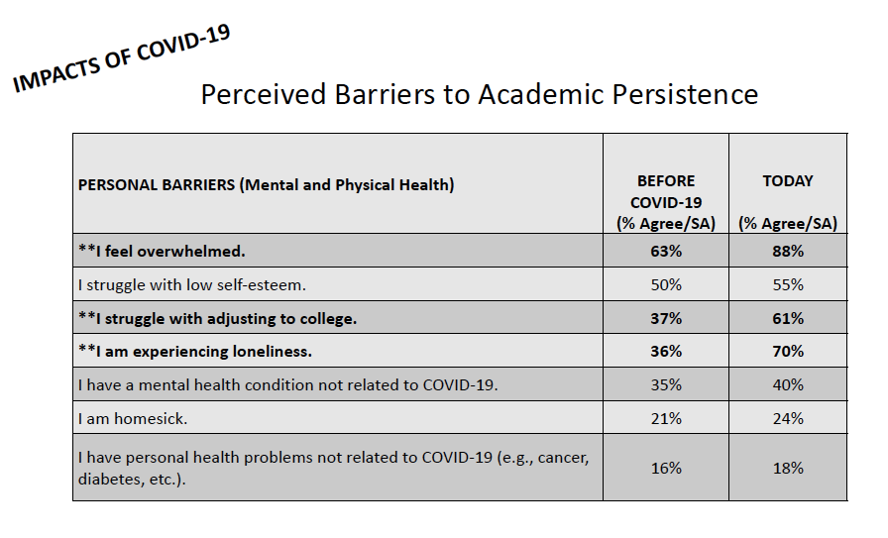
Impact of COVID-19 on University Students
Source: Hartman, H. (2021). Impacts of COVID-19 on college students.

Slide 50
Rowan THRIVE
Six elements:
Social
Emotional
Physical
Community
Purpose
Financial
Consider incorporating the THRIVE elements into your course activities across the semester!

Slide 51
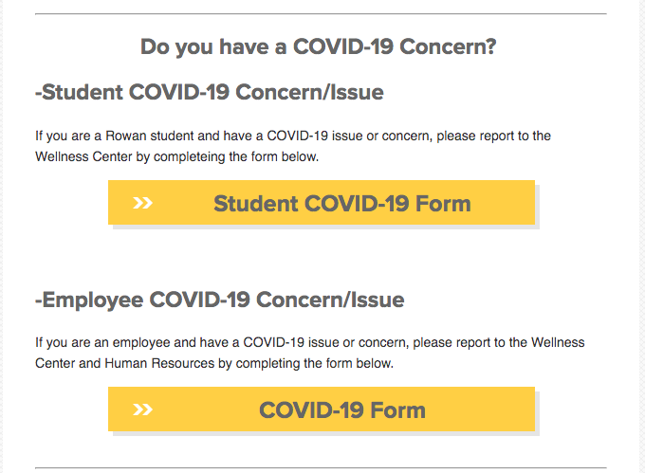
RU Wellness Center
Student Health
Wellness
Crisis counseling
FAQs online
In-person
Phone
Virtual

Slide 52
Thoughts & Questions!

